Slide 1
Tuesday 31st January 2023
LO: To explore the daily life of the Kayapo Tribe.
What can you remember about climates?
What can you remember about biomes?

Slide 2
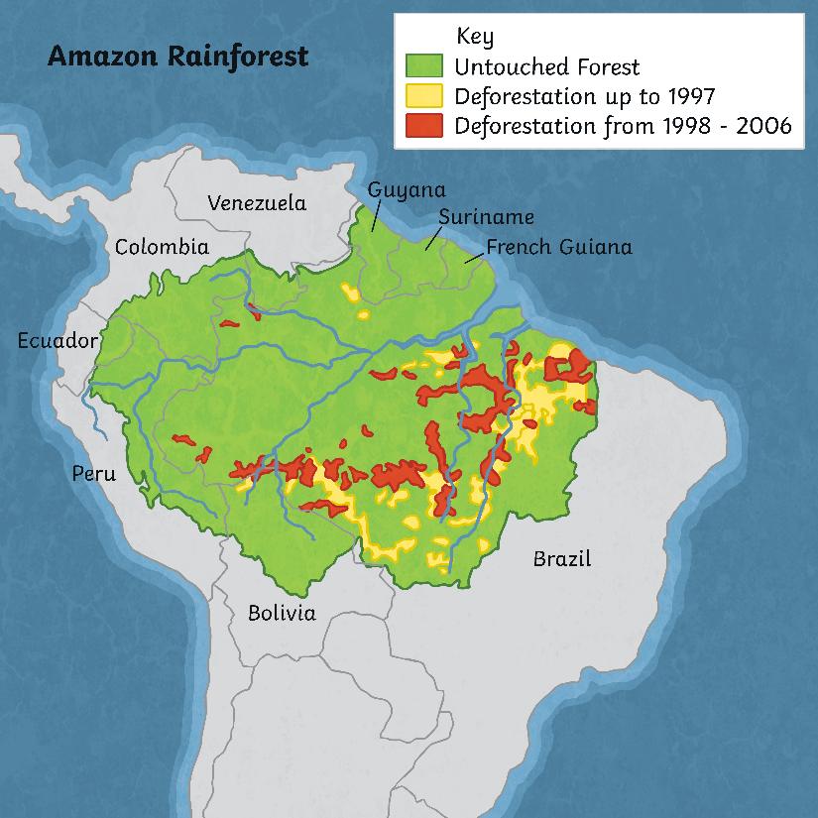
The Amazon Rainforest
The Amazon rainforest is the world’s largest rainforest.
It spreads across parts of nine countries in South America: Guyana, Suriname, French Guiana, Brazil, Bolivia, Peru, Ecuador, Colombia and Venezuela.
As you can see on the map, the biggest part of the Amazon rainforest is in Brazil – 62% in fact. People speak about the Amazon rainforest being ‘the lungs of the Earth’. This is because 15% of the photosynthesis that happens on our planet takes place here. In photosynthesis, plants transform carbon dioxide into oxygen, which humans and animals need to breathe.

Slide 3
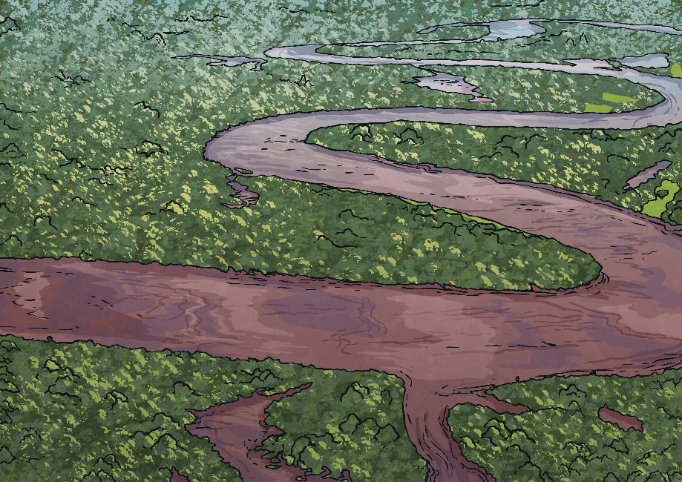
How Many Amazon Tribes Are There?
The Amazon rainforest receives its name from the Amazon river, which you can see in the picture.
It is home to more than 400 tribal people and indigenous groups. These tribal peoples have always lived in the Amazon rainforest, which makes it their ancestral home.
International law recognises the rights of tribal peoples to live in their lands – this is known as tribal peoples’ land rights. Both the United Nations and other organisations that protect human rights have declared that ancestral lands belong to the indigenous groups that live in them and need to be protected. In reality, these indigenous groups are in danger, especially those that have had no contact with other people (known as uncontacted peoples).

Slide 4
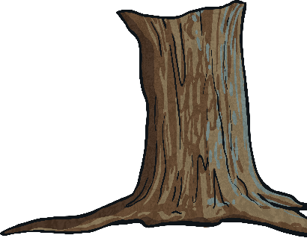
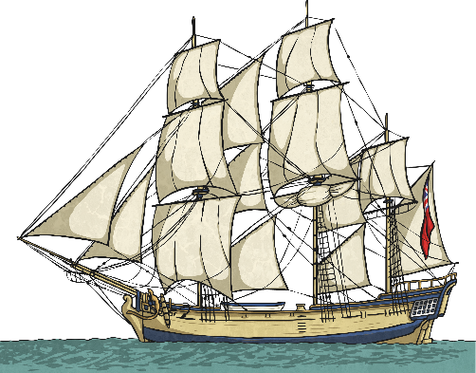
Dangers to Amazon Tribal Peoples
Tribal peoples in the Amazon face many dangers; the most significant being
colonisation and deforestation.
Colonisation
When European settlers arrived in the Americas in the 15th century, millions of people in indigenous groups died due to diseases, such as flu, that the settlers brought with them.
Today, colonisation comes in the form of land grabbers. These are people who settle illegally, often by means of violence, in the lands where tribal peoples live, bringing with them illnesses, such as malaria.
Deforestation
In 2001, the Amazon rainforest covered 5.4 million km² - approximately 87% of the surface it originally covered. Most of the deforestation occurred in the Brazilian forest, mainly due to cattle ranching and crop growing.
However, in areas where tribal peoples have been able to stay in their land, deforestation has been stopped. Scientists have referred to the lands of tribal peoples as ‘the most important barrier to Amazon deforestation’.

Slide 5


The Amazon Rubber Boom
The Amazon Rubber Boom took place between 1879 and 1912.
The boom occurred as a result of several events. Firstly, in the middle of the 19th century, Charles Goodyear discovered that cooking and treating latex from rubber trees turned it into a product that had many different uses. This was followed by the invention of tyres by John Dunlop in 1888. Finally, Henry Ford began mass production of the newly invented motor car at around the same time. These events created a pressing need for rubber.
When it became known that the rubber tree grew abundantly in the Amazon rainforest, thousands of fortune-seekers rushed into the lands of the Amazon tribal peoples. However, they needed workers to collect the latex. Tens of thousands of members of the Amazon indigenous groups were enslaved and those who escaped were victims of the epidemics that the fortune-seekers brought with them.

Slide 6
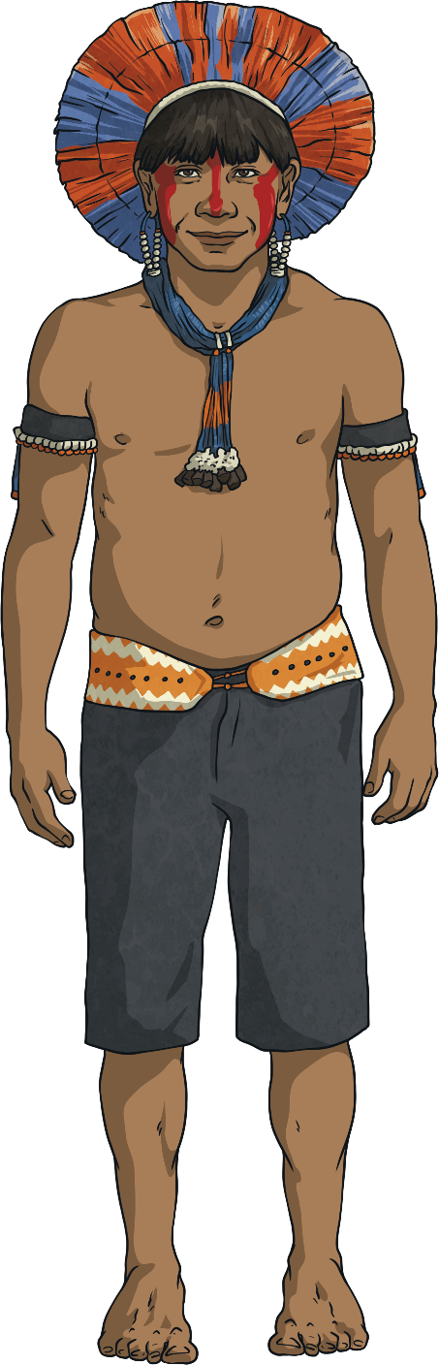
The Kayapo
The Kayapo live in a vast area that spreads across the
Brazilian states of Pará and Mato Grosso. They live
along the Xingu river.
They use intricate black body paint to cover their entire bodies, which allows them to blend into their surroundings when hunting in the forests.
It is estimated that they number around 9,000.
The main threat to their survival comes from the hydroelectric dams that the Brazilian government have begun to build along the Xingu river. The biggest of these is the Belo Monte dam, which is the fourth largest in the world.

Slide 7
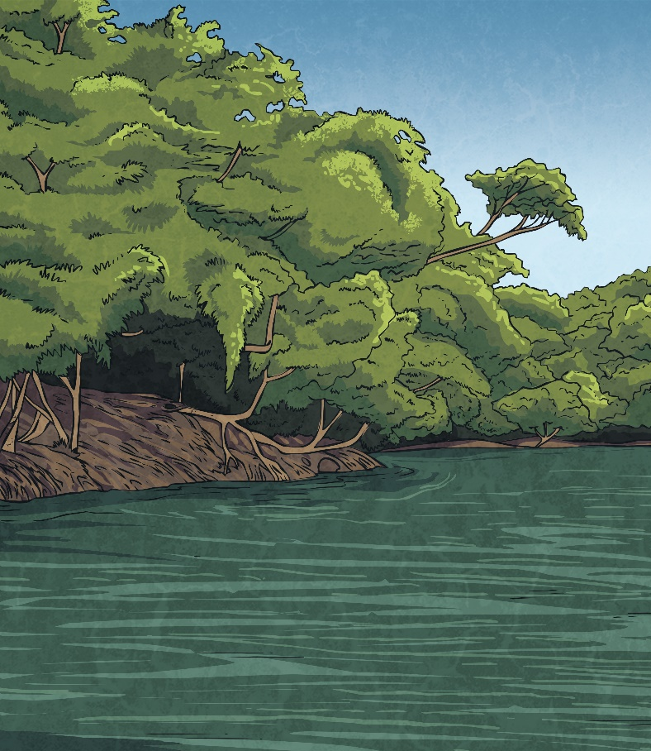
Guardians of the Rainforest
In recent years, scientists have discovered that the lands of tribal peoples act as barriers to deforestation.
Using satellite images, researchers have observed indigenous reserves in Brazil. These are lands that have been protected by the FUNAI so that illegal loggers and land grabbers cannot enter them. They found that deforestation was 66% higher outside indigenous reserves than inside while forest fires were considerably higher outside the reserves.
This shows that Amazon tribes have a truly respectful and environmentally friendly lifestyle and that we can consider them guardians of the rainforest.

Slide 8
This afternoon you will use books and the internet to find out about the lives of the Kayapo tribe. You will need look at different areas of their life and then compare it to your own.
You will need to look at:
What they eat and drink.
What they wear.
Where they live.
The weather/climate.
What they do in their day-to-day business.
- For example, you go to school everyday, what do they do?
Example of what to write:
What do the Kayapo tribe eat and drink?
The Kayapo tribe grow many vegetables to eat; they hunt for meat and fish. The meat they eat is monkeys and turtles. This is different to what we eat in England because we don’t usually hunt for our food and we would not each monkey or turtles, instead with eat beef, lamb and chicken. It is similar because we both eat fish and vegetables.

Slide 9
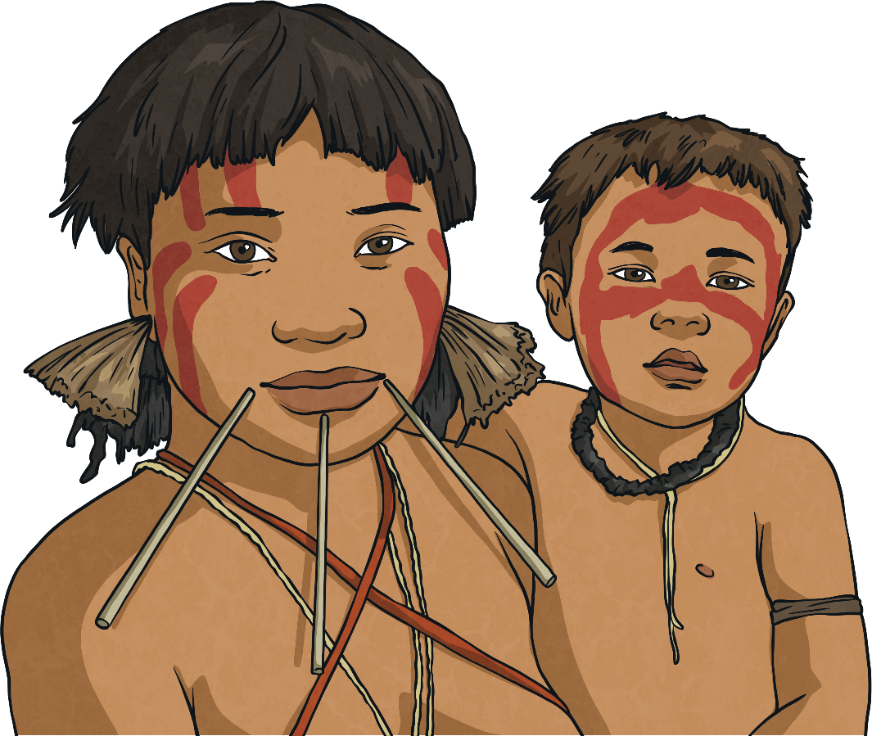
The Yanomami
The Yanomami are considered the largest isolated indigenous group in South America. Their population is approximately 35,000.
They live in northern Brazil and southern Venezuela in communal, circular homes, known as ‘yanos’ or ‘shabonos’. The yano has a big, central space for celebrations. The Yanomami sleep in hammocks made from cotton or palm fibre, hung from the roofed area of the yano.
One of the greatest threats to their survival is a road that was built in the 1970s. This was used during a gold rush in the 1980s, where 40,000 gold miners invaded the Yanomami land after a survey project detected mineral deposits in the area. The
gold prospectors brought diseases to the area, to which the Yanomami had no immunity. In only seven years, 20% of the Yanomami died.

Slide 10
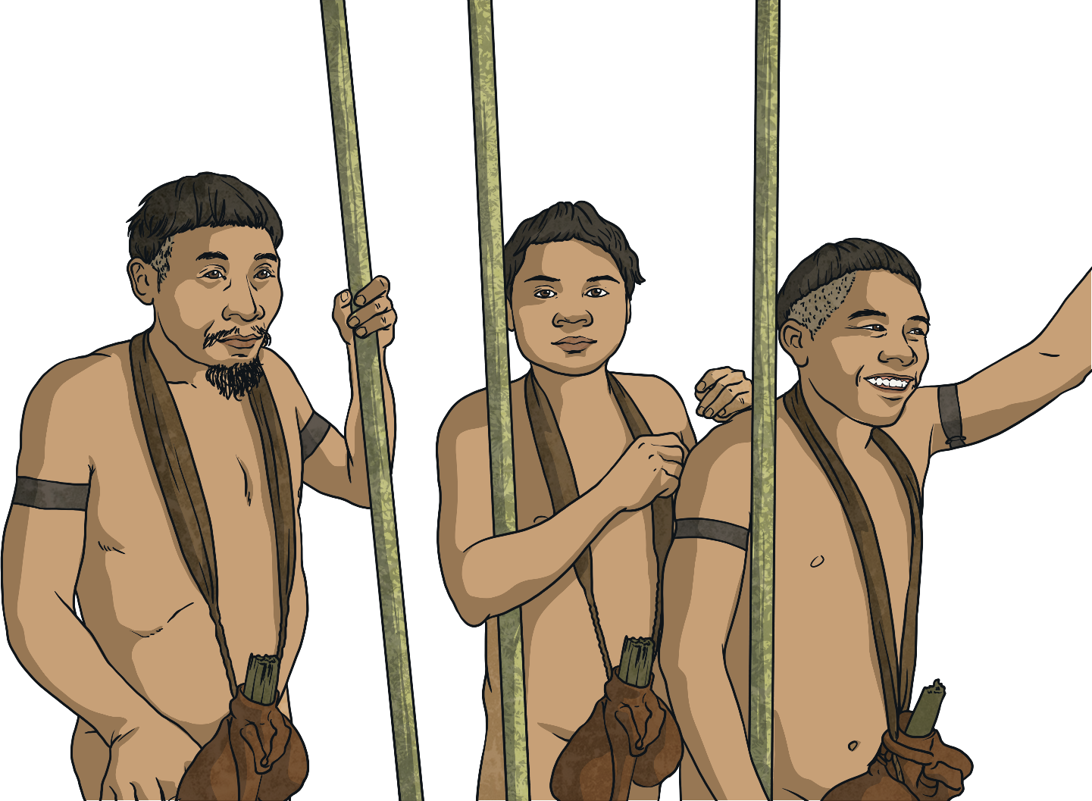
The Korubo
The Korubo are one of the indigenous groups living in the Javari Valley indigenous territory in the western Brazilian Amazon.
Their main threat comes from the outbreaks of diseases, particularly Hepatitis B and C, that have taken place since the tribe was contacted in the 1990s.
The majority of the Korubo are uncontacted. After various attempts, the Brazilian FUNAI (the government’s protection agency for indigenous peoples) contacted a small group of them to provide protection in the form of vaccines.

Slide 11
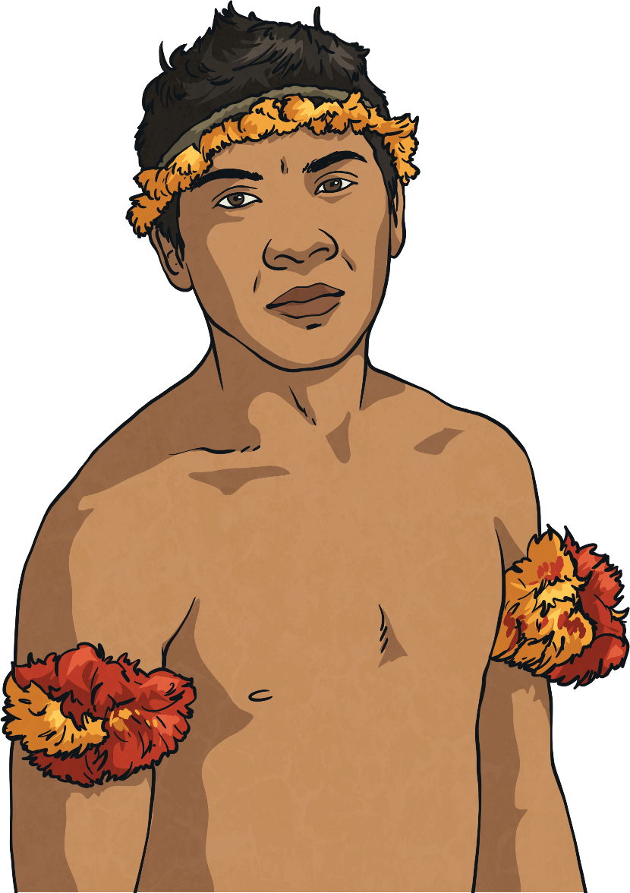
The Awá
The Awá live in the eastern Amazon rainforest. There are approximately 350 members, 100 of which are uncontacted.
Although they originally lived in settlements, they adopted a nomadic hunter-gatherer lifestyle around 1800 to escape from European invaders.
Having had so little contact, or none in the case of their uncontacted members, with the outside world, they are especially vulnerable to diseases. Illegal logging companies have been accused of hiring gunmen to kill them so that they can exploit the rainforest. As they use bows and arrows to hunt, they cannot defend themselves against firearms.

Slide 12
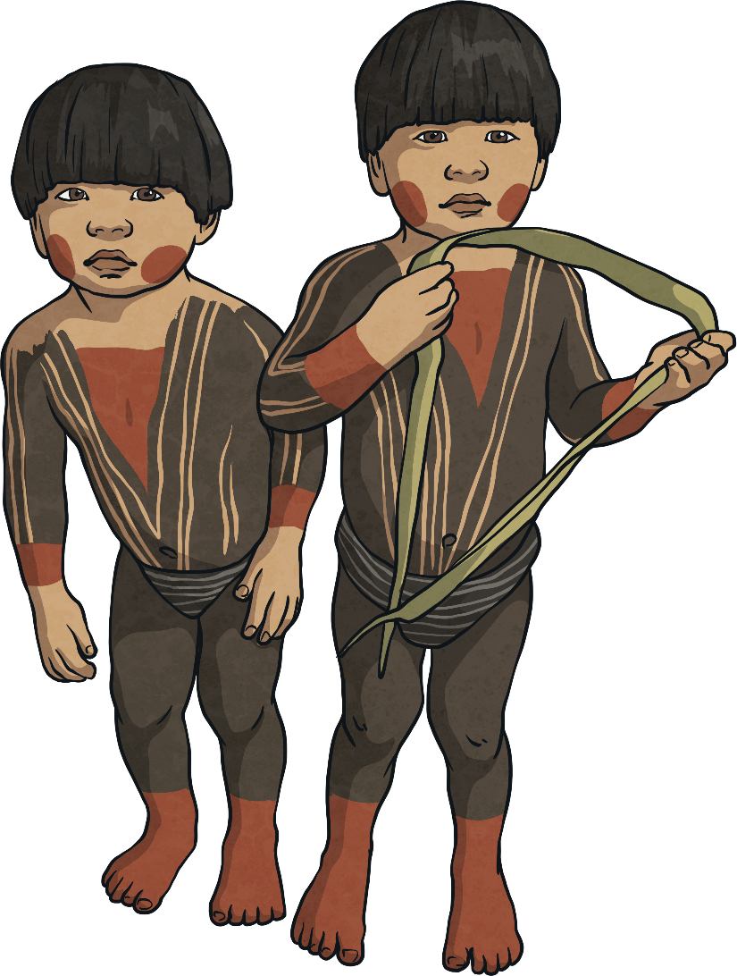
The Tupi
Before colonisation, the Tupi were one of the most numerous tribal peoples
indigenous to Brazil.
It is estimated that, in 1500 when the Portuguese arrived in Brazil, their population was around 1 million - nearly the same as the population in Portugal at that time.
However, they were enslaved or killed by diseases transmitted by the Portuguese, and later, Brazilian settlers. Having never been exposed to these diseases, the Tupi had no immunity to them. One of these diseases was smallpox.
Today, the Tupinambá are one of the few remaining Tupi communities who have had their land rights recognised in the Brazilian state of Bahia.

